Slide 1





PRESENTATION 2026
Student Name
Student Email
Prachi Nitin Palkar
prachiii1856@gmail.com
Mentor Name
Umamaheshwari Ma’am

Slide 2

Outline
Abstract of the Project
Problem Statement
Proposed Solution
System Architecture
Live Demo of the Project
Embedded Video of Project
Conclusion
Future Scope

Slide 3
Abstract
1.Project Overview
This project focuses on transforming raw inventory and order fulfillment data into meaningful insights using Microsoft Excel and Power BI.
2. Objective
The main objective is to clean and analyze data to improve inventory management and business decision making. The dataset contains issues such as duplicate records, missing values, and inconsistent categories, which are corrected using Excel data cleaning techniques and create an interactive dashboard using PowerBI to get business insights.

Slide 4
Abstract
3. Tools Used
Analysis is performed using Pivot Tables and formulas in Excel, and the results are visualized through interactive dashboards in Power BI.
4. Expected Outcomes
The final outcome helps businesses track stock levels, monitor order fulfillment, and improve operational efficiency.

Slide 5
Abstract
5.Unique aspects
Complete data cleaning performed manually using Excel tools
Use of Pivot Tables for business insight generation
Creation of an interactive Power BI dashboard with KPIs and slicers
End-to-end workflow from raw data to visualization
Focus on real world inventory and fulfillment problems
The final outcome helps businesses track stock levels, monitor order fulfillment, and improve operational efficiency.

Slide 6

Problem Statement
1.Core Problem
The retail and e-commerce industry generates large amounts of data, but:
Data is often unclean and inconsistent
Duplicate and missing values reduce accuracy
No proper dashboards for insights
Manual analysis is time-consuming

Slide 7
Problem Statement
2.Key problems that is significant or challenging
Poor data quality affecting decisions
Inefficient inventory tracking
Revenue miscalculations
Inconsistent product categories
Lack of visualization and KPIs
Difficulty in tracking order fulfillment.

Slide 8
Problem Statement
3.Target Users
Retail businesses
Inventory managers
E-commerce companies
Business decision makers
These stakeholders rely on accurate data for managing stock, tracking orders, and analyzing performance.

Slide 9
Problem Statement
4.Limitations
Manual data cleaning is time-consuming and error-prone
Lack of structured formats leads to inconsistent reporting
Absence of dashboards makes it difficult to interpret data quickly
Traditional methods do not provide real-time insights
Difficulty in analyzing large datasets without proper tools

Slide 10
Problem Statement
5.Scope
Focuses on inventory and order fulfillment dataset
Includes data cleaning, analysis, and visualization
Covers stock levels, categories, and order status
Uses Excel and Power BI for processing and insights

Slide 11

Proposed Solution
This project uses Excel and Power BI to solve inventory and fulfillment issues.
Steps:
Data Collection
Dataset taken from Kaggle
Data Cleaning in Excel
Remove duplicates
Handle missing values
Correct data types
Standardize category names
Data Analysis in Excel
Pivot Tables
KPI calculations
Sorting and filtering

Slide 12
Proposed Solution
Visualization in Power BI
Interactive dashboards
Charts and graphs
Slicers for filtering
Benefits:
Accurate and clean data
Better inventory management
Easy data analysis
Improved decision-making
Visual representation of data

Slide 13
System Architecture
Data Input / Source
Processing / Analysis
AI / Tool Integration
Output / Dashboard

Slide 14
1. Data input/ Source
Excel dataset from Kaggle
Contains:
Order ID
Product Name
Category
Stock levels
Order status
2. Processing / Analysis (Excel)
Removing duplicates using Remove Duplicates tool
Handling missing values using Find & Replace
Standardizing categories using Replace function
Correcting data types using filters and formatting
Data validation using Conditional Formatting
Analysis Techniques:
Pivot Tables
Sorting & Filtering
Basic Excel formulas

Slide 15
3. Tool Integration
Microsoft Excel → Data cleaning & analysis
Power BI → Data visualization & dashboard creation
4. Output / Dashboard (Power BI)
Interactive dashboard with:
KPI cards
Bar charts
Pie charts
Insights Generated:
Stock availability
Category-wise performance
Region-wise analysis
Order fulfillment tracking

Slide 16
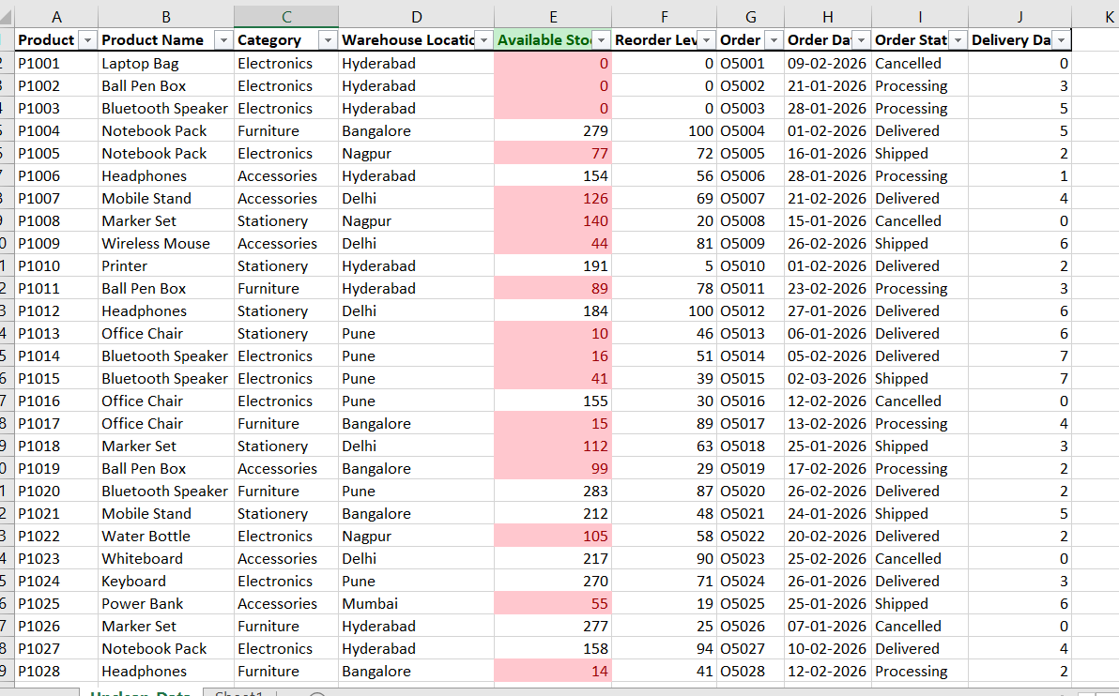
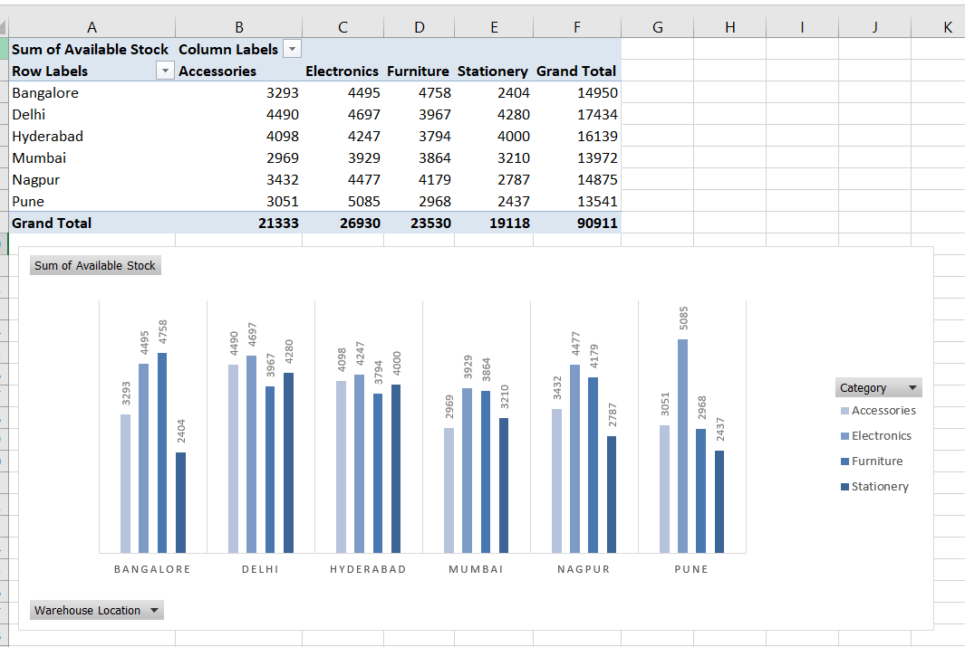
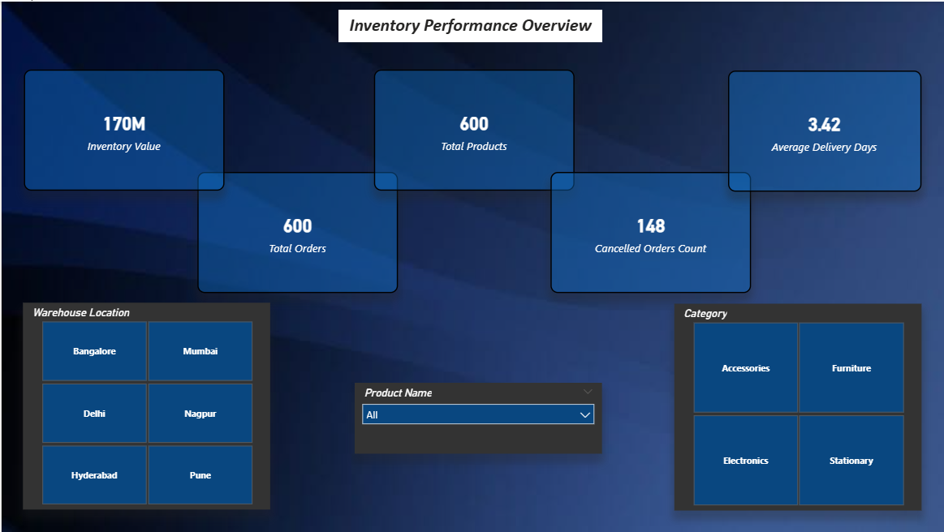
Live Demo of Project
Here's the list of some demo screenshots / features of the project:
Demo 1
Demo 2
Demo 3
[Add description of Demo 2 here — what this demo shows, key features, and results achieved.]

Slide 17
Video of Project Demo
[https://your-project-demo-link.com]
▶
[Insert your project demo video.
You can embed a video your live project.]

Slide 18

Conclusion
This project successfully converted raw inventory data into structured and meaningful information using Excel and Power BI.
Key achievements:
Cleaned and organized dataset
Performed effective data analysis
Created interactive dashboards
Improved inventory tracking and reporting
The project demonstrates how Excel and Power BI can be used effectively for business data analysis and decision-making.
CONCLUSION

Slide 19

Future Scope
Integration with live databases
Automation using Power BI refresh
Advanced dashboards with more KPIs
Integration with business systems Expansion to larger datasets

Slide 20
Thank You
AICW Fellowship | Student Project Presentation 2026
LinkedIn | Edunet Foundation

